Slide 1
Semantic model overview
for RD-Connect identifiers

Slide 2
Background
The RD-Connect platform aims to provide access to services and data sources relevant for rare diseases e.g. ID card, biobanks, registries, omics data such as from NeurOmics/Eurenomics
Starting point: key data sourcing tools and databases are unconnected
A list of key identifiers was provided that are in these sources, with the request to connect them

Slide 3
Initial identifier list (the task at hand)
BioBank ID
(Global) Patient ID
Donor ID
Experiment ID
Sample ID
EGA Sample ID
Notes:
Also see this working spreadsheet
We couple this task to the biobank-registry data linkage p.o.c. by linking sample data for the p.o.c. to the classes in this model

Slide 4
Goals
Elicit the semantic relations between the elements referenced by the identifiers
Provide the model for use in the RD-Connect platform (and RD systems in general)
Elixir pilot: align with development of interoperability backbone / FAIR data tools

Slide 5
Revised identifier list
BioBank ID
Patient ID
Donor ID
Experiment ID subdivided in
Experiment ID (=aggregate)
Experimental process ID
Sample ID = Specimen ID
subsumes EGA Sample ID
Future additions for registry-biobank p.o.c. use case:
Phenotype
Disease
more properties
(Note: additional classes and properties feature in the p.o.c. work of Rajaram)

Slide 6
Ontologies used
OBIB/OBO Foundry
Human being
Patient/donor role
identifier
Object Properties
ORE
Aggregation
Aggregate properties
EDAM
Identifier
Dublin core
identifier property
SKOS
Mappings

Slide 7
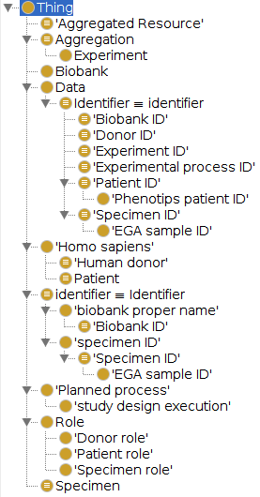
Class overview ontology v0.01
Aggregate material referred to by ‘Experiment ID’ in RD-Connect
From ORE (extendable to accommodate research objects)
The list of identifiers provided by the RD-Connect platform
RD-Connect classes subsumed under EDAM Identifier
Classes defined by ‘Person’ and Patient/Donor role (OBIB)
From OBO Foundry (OBIB)
The list of identifiers provided by the RD-Connect platform
subsumed under OBIB identifier
For actual Experiments as defined by a process
From OBO Foundry (OBIB)
Roles from OBO Foundry (OBIB)
Specimen; nb often referred to by as ‘samples’ in RD-Connect

Slide 8
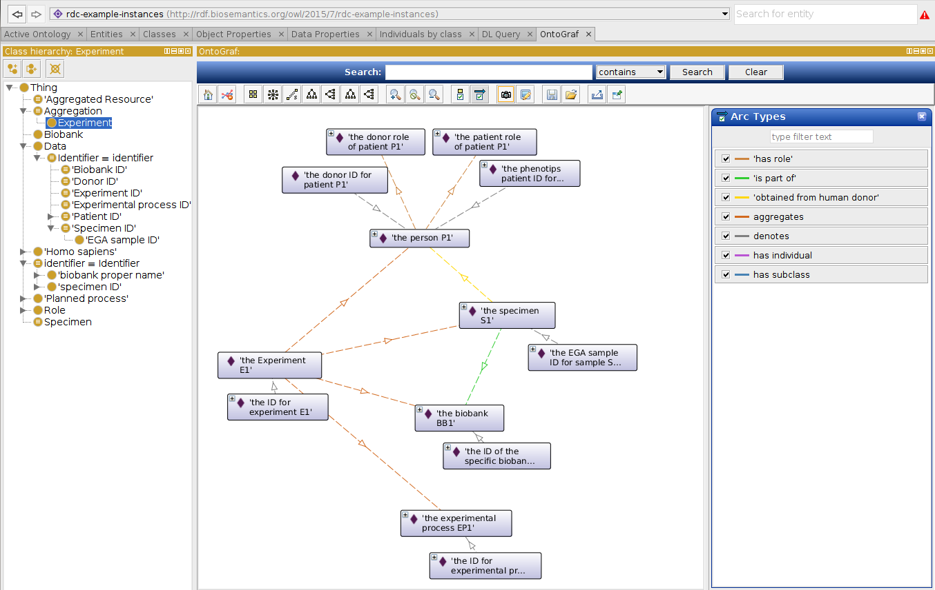
Example instances
has role
dc:identifier
denotes
dc:identifier
denotes
has role
“identifier value”
“identifier value”
obtained from human donor
aggregates
denotes
aggregates
is part of
denotes
dc:identifier
aggregates
“identifier value”
dc:identifier
aggregates
denotes
dc:identifier
“identifier value”
“identifier value”
denotes
dc:identifier
“identifier value”

Slide 9
Specific issues
Need Identifier class? (see next slide)
EDAM:Identifier =? OBIB:identifier
advice on which to prefer is welcome
what is essential difference between EDAM:Identifier and OBIB:identifier?
Marco’s preference: all identifiers for the RD platform under one class in RD model; other ontology mappings in separate mapping model (and/or linksets).
Identifier ‘denotes’ Person|Specimen|...
correct predicate?
Predicate to link Specimen and Person
temporary used my own predicate: ’obtained from human donor’
Specimen ‘is part of’ Biobank
correct predicate?
For Pedro Sernadella: COEUS ontology to map to?
For Heimo and Robert: ID-card model to map to?
SKOS vs Class mapping [SOLUTIONS PROVIDED]

Slide 10
Issue: would B work as well as A?
or is there a solution ‘C’?
= ‘Identifier’
(subclass of EDAM:Identifier and/or OBIB:identifier)
A
denotes
dc:identifier
“identifier value”
Some instance (e.g. of Person class)
Instance of Identifier class
= ‘Identifiable Thing’
(NOT subclass of EDAM:Identifier, and/or OBIB:identifier)
B
dc:identifier
“identifier value”
Some instance (e.g. of Person class)

Slide 11
Files
owl/rdf-xml
Main model
rdc-core
core model with only the identifiers (RD-Connect namespace)
rdc-meta
the main semantic model
imports rdc-core, uses URIs from common ontologies
Additional models
rdc-example-instances
example instances
rdc-thesaurus
SKOS based mappings
treats classes from other ontologies as instances of SKOS concepts
rdc-mappings
ontological mappings and mapping to rdc-thesaurus
rdc-extended (incomplete)
provisional model to show all classes/properties that are implied by using the classes from the common ontologies (i.e. using the ‘copy’ function in Protege)

